Slide 1
INFORMATION RETRIEVAL SYSTEMS (IRS)
Course Instructor
P.Veera Swamy
Assistant Professor

Slide 2
UNIT-1 SYLLABUS
Introduction: Definition, Objectives, Functional
Overview, Relationship to Digital libraries and Data
DBMS,
Warehouses. Capabilities:
Information Retrieval System Search, Browse, Miscellaneous.

Slide 3
INTRODUCTION
DATA STRUCTURES
DATA BASE MANAGEMENT SYSTEMS
DATA WAREHOUSE
DATA MINING
INFORMATION RETRIEVAL SYSTEM

Slide 4
TYPES OF INFORMATION
Text
Image
Audio
Video
Other Multimedia objects
Information retrieval is the activity of obtaining information resources relevant to an information need from a collection of information resources.

Slide 5
DEFINITION
IRS is a system that is capable of storage, retrieval and maintenance of information to accomplish the task of the user.An IR system facilitates a user in find the information the user needs.
Only data type is “Text” to process the information retrieval functionality processing.
Other data types used for highly informative sources but the primary link for retrieval is text.

Slide 6
Terms used in I.R.S:
User → End user
Item → Smallest complete unit (i/p’s)
Document → Storage of information, News paper, Book, Magazine etc.
Applications of IRS:
Academic Research
Military & other Govt. entities
Research development etc.

Slide 7
IRS using WAIS (Wide Area Information servers ) capable & recently advanced servers (INFOSEEK, EXITE) provided a new avenue for accessing to tera bytes of information
IRS consists of a S/W program that facilitates a user in finding the information of user needs.
Also uses H/W & special H/W to support the sub function & to convert non-textual sources to searchable media

Slide 8
OBJECTIVE
To minimizes the overhead of a user locating needed information
Users Overhead:-
Time required finding the needed information
Time required for actual reading the relevant data
Total time required to reading an item containing the needed information.
Steps: 1) Query Generation
Query Execution
Scanning results of query to select items to read
Reading non-relevant items
Ex: Student finding the information which is sufficient to do a research paper.

Slide 9
PERFORMANCE MEASURES
The two major measures commonly associated with information systems are precision and recall
Precision: The ability to retrieve top-ranked documents that are mostly relevant.
Recall: The ability of the search to find all of the relevant items in the corpus.

Slide 10
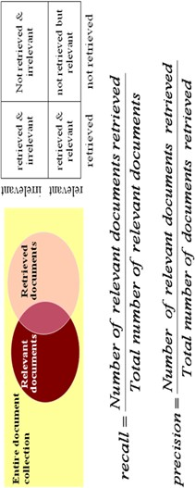

Slide 11
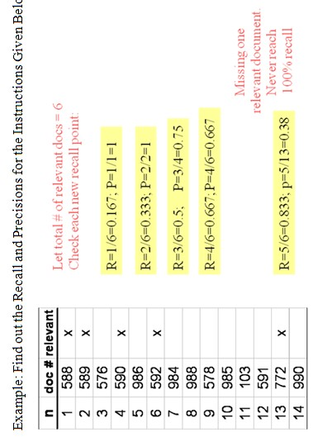

Slide 12
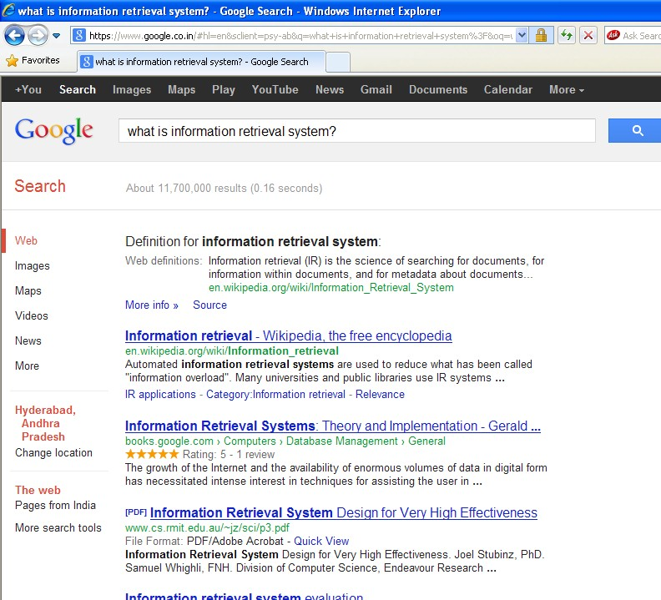


USER ITEM
TOTAL SEARCH RESULTS & PROCESSING TIME
TOP RANKED DOCUMENTS
SEARCH RESULT

Slide 13
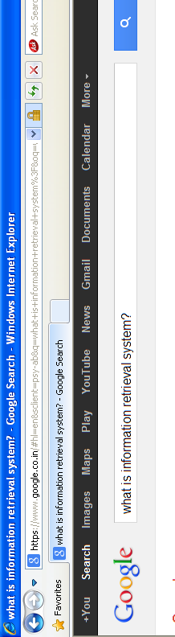
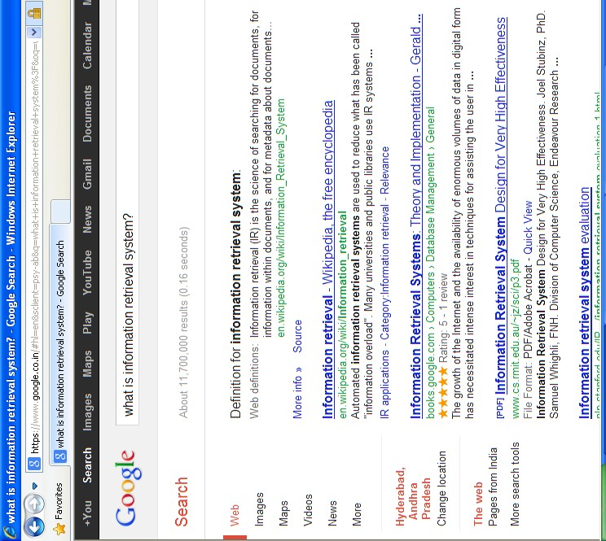


Google
Web

Slide 14
FUNCTIONAL OVERVIEW
Four major functional processes
Item Normalization
Selective Dissemination of Information
Archival Document Database Search
Index Database Search + Automatic File Build Process (Support index files)

Slide 15
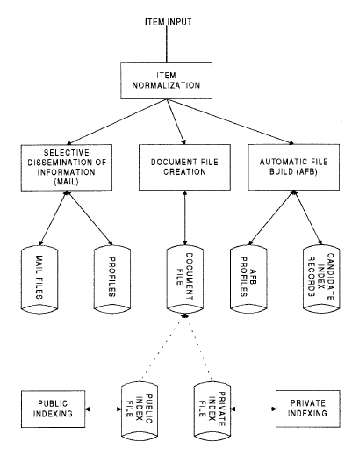
Functional Overview
Boxes represents the Functions and Disks represents the Data storage

Slide 16
ITEM NORMALIZATION:
Normalizes the incoming items to a standard format, translates multiple external formats that might be received into a single consistent data structure that can be manipulated by the functional process.
→ It provides the logical restructuring of the item
→ It creates a searchable data structure

Slide 17
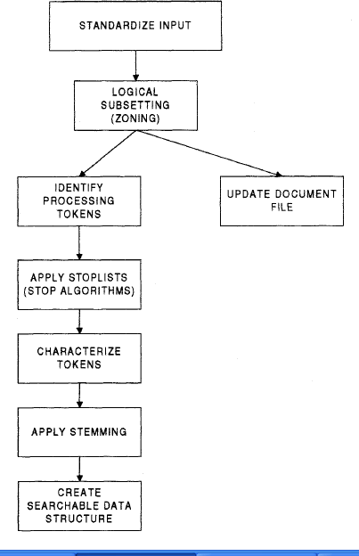
FUNCTIONAL OVERVIEW:ITEM NORMALIZATION

Slide 18
STANDARDIZE INPUT
It takes the different external formats of input data & performs the translation to the format to the system
System allows single/multiple formats
Ex: Translating foreign languages into Unicode(UTF- 8)
Multimedia adds an extra dimension to the Normalization process. In all the cases (identifying the different formats of images, audio, video files etc) the input source is encoded into a digital format
The standardizing(encoding process) is allows easy access by browsers is greater for multimedia .

Slide 19
ZONING:-
The parsing of the item into logical sub-divisions that have meaning to the user is called Zoning.
It is visible to the user & increases the precision of a search & optimize the display.
Typical item is sub-divided into items(zones) which may overlap & can be hierarchical such as “Title”, “Author”, “Abstract”, “Plain text”, “Conclusion” etc.
Ex:- If the user is searching for articles written by Einstein, the search should not include the Bibliography, which could include references to the articles written by “Einstein”
By this process the user can retrieve the relevant data which is needed to accomplish a task easily.

Slide 20
IDENTIFY PROCESSING TOKEN:-
The term processing token is used because a“word” is not the most efficient unit on which to base search structures.
The first step in identification of a processing token consists of determining a word.
It determines a word by dividing input symbols into 3 classes.
Valid word symbols
A word is defined as a continuous set of word symbols bounded by inter-word symbols.
Ex:- Alphabetic characters & numbers
Inter-word symbols
It many systems Inter-word symbols are Non-searchable & carefully selected. The Extraction is depends on language domain of system.
Ex: - Blank, periods & semicolon.
Special Processing symbols
Some symbols that may require special processing.
Ex:- A Hyphen can be used many items at the end of a line for the continuous word “Small business-men”.

Slide 21
STOP LIST ALGORITHM:-
It is applied to the list of potential processing token
The objective of stop list function is to save System Resources by eliminating from the set of searchable processing tokens those that have little value to the system
Ex:- Any word found in almost every item would have no discrimination value during a search. Part of speech such as articles (e.g.“The”) have no search value & are not useful part of a users Query. By eliminating these words the system saves the processing & storage.

Slide 22
CHARACTERIZING A TOKEN:-
The processing tokens is identification of any specific word characteristics.
The characteristic is used in system to assist in disambiguation of a particular word
Morphological analysis of the processing tokens part of speech include here.
Ex:- Characteristics may classify a token as a member of a higher class of tokens such as“European Country” (or) “Financial Institution”.
Another example of characterization is if uppercase should be preserved.
Other characterizations typically treated separately from text are numbers & dates.

Slide 23
APPLY STEMMING:-
Most systems apply stemming algorithms to normalize the token to a standard semantic representation.
Stemming is a trade off between precision of a search versus standardization to reduce system overhead in expanding a search term
It removes “Word” endings.
Ex: Item Computing Process
Stemmed Item Compute Process
Improves the precision of a search.

Slide 24
CREATE SEARCHABLE DATA STRUCTURES:-
The searchable data structure is the internal representation(not visible to the user) of items that the user query searches.
This structures contain the semantic concepts represents the items in the database and limits what a user can find as a result of their search.
Ex: Inverted File Structure, N-Gram Data Structure, Signature file structure etc…

Slide 25
SELECTIVE DISSEMINATION OF INFORMATION(MAIL PROCESS)
It provides the capability to dynamically compare newly received items in the information system against standing statement of interest of users and deliver the item to those users whose statement of interest matches the contexts of the item.
Mail process is composed of
---Search process
---User statement of interest (profiles)
---User Mail files.
As item is retrieved it is processed against every users profile. Profile consists of a typically broad search statement along with a list of user mail files that will receive the document if the search statement in the profile is satisfied.
When the user items are satisfied, the item is placed in the
mail files associated with the profile.
Items in mail files are typically viewed in time of receipt order & automatically deleted after a specific period.

Slide 26
DOCUMENT DB SEARCH
It provides the capability for a query to search
against all items retrieved by the system
The Document data base search is composed of
--- Search process
--- User entered queries (typically adhoc Queries)
--- Document DB which contains all items that have been received , Processed & stored by system.
Document DB can be very large hundreds of millions of items or more. The items in Document DB do not change once Retrieved.
The value o f much information quickly decreases over time.
The documents in the Mail files are also in the document database, since they logically are input to both processes.

Slide 27
INDEX DATA BASE SEARCH
When an item is determined to be of interest, a user may want to save it for future reference i.e. filing it in an information system this accomplished via Index process.
User can logically store an items in a file along with additional index terms & descriptive that the user wants to associate with the item.
Ex:- Index file is card catalog in a library.
The index DB search process provides the capability to create indexes and search them.
The user may search the index and retrieve the index and/or the document it references.
It is also provides the capability to search the index and then search the items referenced by the index records that satisfied the index portion of the query.

Slide 28
INDEX DATA BASE SEARCH
There are 2 classes of Index file.
(1) Public Index File Maintained by professional Libraries
(2) Private Index File Limited access list
To assist the users in generating indexes the system provides a process called Automatic File Build. This capability processes selected incoming documents and automatically determine potential indexing for the item.
The capability to create private & public index files is frequently implemented via structured DBMS.

Slide 29
RELATIONSHIP TO DATABASE MANAGEMENT SYSTEMS
DBMS
Optimized to handle “structured” data
Structured data is well defined data typically represented by table
Specific request, return desired information
IR System
Software that has the features and functions required to manipulate “information” items
Information is fuzzy text
A high probability of not finding all the items a user is looking for
The user has to refine his search to locate additional items of interest (iterative search)

Slide 30
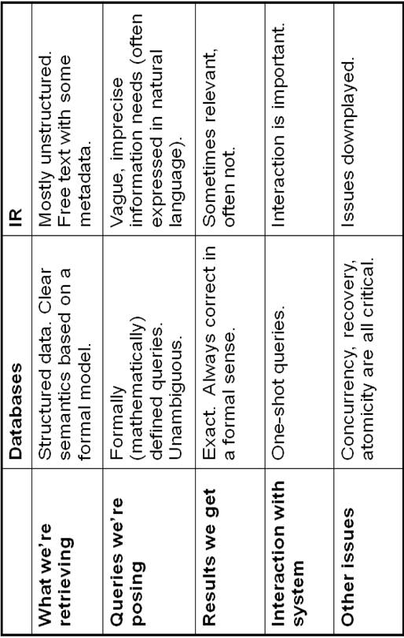

Slide 31
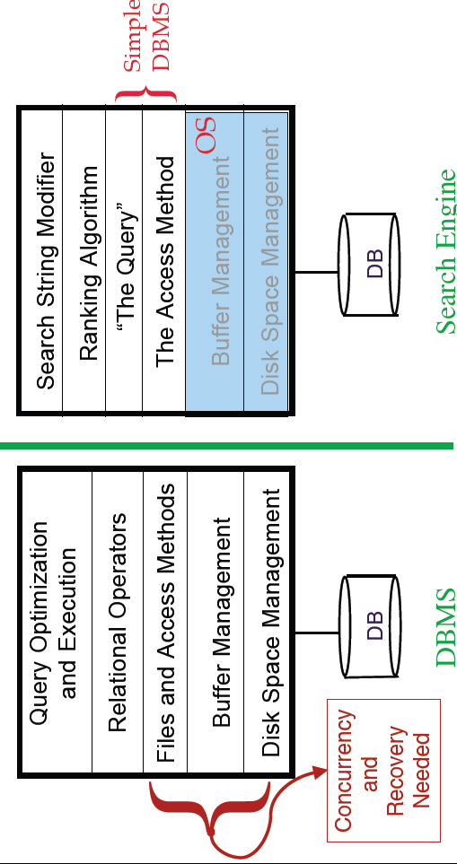

Slide 32
DIGITAL LIBRARIES AND DATA WAREHOUSES
Two other systems frequently described in the context of information retrieval are Digital Libraries and Data Warehouses(or Data marts).
Information Storage and Retrieval technology has addressed a small subset of the issues associated with Digital Libraries.
The storage and retrieval of the digital version is a major concern to digital libraries.
Digital Libraries were forced to make maximum use of electronic tools to facilitate the storage and retrieval process with the help of World Wide Web(WWW) and information sources(ex. Publishers, News agencies, Wire services, Ratio broadcasts) via Internet.

Slide 33
DIGITAL LIBRARIES AND DATA WAREHOUSES
A data warehouse consists of the data, an information directory that describes the contents and meaning of the data being stored.
An input function that captures data and moves it to the data warehouse, data search and manipulation tools that allow users the means to access and analyze the warehouse data.
Data warehouses are similar to information storage and retrieval systems in that they both have a need for search and retrieval of information. But a data warehouse is more focused on structured data and decision support technologies.
Data mining (Originally called KDD)is a search process that automatically analyzes and extract data .

Slide 34
INFORMATION RETRIEVAL
SYSTEMS CAPABILITIES

Slide 35
INFORMATION RETRIEVAL SYSTEMS CAPABILITIES
Search Capabilities : Querying for data
Browse capabilities : Browsing or Acquiring the Knowledge from the Search Results
Miscellaneous capabilities : Other Methods

Slide 36
SEARCH CAPABILITIES
The objective of the search capability is to allow for a mapping between a user’s specified need and the items in the information database that will answer that need.
The search query statement is the means that the user employs to communicate a description of the needed information to the system.
The search capabilities address both Natural Language(Ranked) and Boolean logic queries. The algorithms used for searching are called Natural language, Boolean logic processing.

Slide 37
SEARCH CAPABILITIES
Given the following natural language query statement where the importance of a particular search term is indicated by a value in parenthesis between 0.0 and 1.0 with 1.0 being the most important.
Example:Weighting of search terms
Find articles that discuss automobile emissions(.9) or sulfur dioxide(.3) on the farming industry.
The system would recognize in its importance ranking and item selection process that automobile emissions are far more important than items discussing sulfur dioxide problems.

Slide 38
SEARCH FUNCTIONS
The functions define the relationships between the terms in the search statement
Boolean
Natural Language
Proximity
Contiguous word phrases (CWP)
Fuzzy searches
Interpretation of a particular word
Term masking
Numeric and date range
Concept/Thesaurus expansion

Slide 39
BOOLEAN LOGIC
Boolean logic allows
a user together
to logically to define
relate what
multiple concepts information is needed.
Typically the Boolean functions apply to processing tokens identified anywhere within an item.
The typical Boolean operators are AND, OR, and NOT.
These are implemented using set Intersection, set Union, set Difference Procedures.
A special type of Boolean search is called “M of N”
EX:Find any item containing any two of the following terms: “AA”, “BB”, “CC”.
This can be expanded into a Boolean search that performs an AND between all combinations of two terms and “OR”s the results together ((AA AND BB)or(AA AND CC)or(BB AND CC)).

Slide 40

EXAMPLE
Search Statement | System Operation
COMPUTER OR PROCESSOR NOT MAINFRAME | Select all items discussing Computers and/or Processors that do not discuss Mainframes
COMPUTER OR (PROCESSOR NOT MAINFRAME) | Select all items discussing Computers and/or items that discuss Processors and do not discuss Mainframes
COMPUTER AND NOT PROCESSOR OR MAINFRAME | Select all items that discuss Computers and not Processors or mainframes in the item

Slide 41
PROXIMITY
Proximity used to restrict the distance allowed within an item between two search terms.The semantic concept is that the closer two terms are found in a text, the more likely they are related in the description of a particular concept
Increase the precision of a search
If the term COMPUTER & DESIGN are found in a few words of each other then the item is more likely to be discussing the design of computer than if the words are paragraphs apart.
Typical format
TERM1 within “m” “units” of TERM2
The distance operator “m” is an integer number and units are in Characters, Words, Sentences, or Paragraphs
A special case of the Proximity operator is the Adjacent (ADJ) operator that normally has a distance operator of one and a forward only direction.

Slide 42

EXAMPLE
Search Statement | System Operation
“Venetian” ADJ “Blind” | Would find items that mention a Venetian Blind on a window but not items discuss a Blind Venetian
“United” within five words of “American” | Would hit on “United States and American interests”, “United Airlines and American Airlines”, not on “United States of America and the American dream”
“Nuclear” within zero paragraphs of “clean-up” | Would find items that have “nuclear” and “clean-up” in the same paragraph

Slide 43
CONTIGUOUS WORD PHRASE
A Contiguous Word Phrase (CWP) is both a way of specifying a query term and a special search operator. It is a two or more words treated as a single semantic unit.
Example: “United States of America”
A CWP also acts like a special search operator that is similar to the proximity(ADJ)operator but allows for additional specificity.
Contiguous Word Phrases are called Literal Strings in WAIS and Exact Phrases in Retrieval Ware. In WAIS multiple Adjacency (ADJ) operators are used to define a Literal String (e.g., "United" ADJ States" ADJ "of' ADJ "America").

Slide 44
FUZZY SEARCH
Fuzzy Searches provide the capability to locate spellings of words that are similar to the entered search terms. This function is primarily used to compensate for errors in spelling of words.
It increases recall at the expense of decreasing precision.
Example:
A Fuzzy Search on the term "computer" would automatically include the following words from the information database:"computer,”“compiter," "conputer," "computter," "compute.“
An additional enhancement may lookup the proposed alternative spelling and if it is a valid word with a different meaning(e.g “Commuter”).

Slide 45
TERM MASKING
The ability to expand a query term by masking a portion of the term and accepting as valid any processing token that maps to the unmasked portion of the term
Types of search term masking
Fixed length “don’t care”: It is a single position mask. It masks out any symbol in a particular position or the lack of that position in a word.
Ex: multi$national matches “multi-national.”
Variable length “don’t care”: allows masking of any number of characters within a processing token. The masking may be in the front, at the end, at both front and end, or imbedded.
Example:
Suffix search
Prefix search
Imbedded string search
“*computer” “computer*” “*computer*”

Slide 46

EXAMPLE
Search Statement | System Operation
Multi$national | Matches “multi-national,” “multiynational”, “multinational” but does not match “multi national” since it is two PTs
*computer | Matches “minicomputer” “microcomputer” or “computer”
comput* | Matches “computers,” “computing,” “computers”
*comput* | Matches “minicomputing” “microcomputers” or “compute”

Slide 47
NUMERIC AND DATE RANGES
Term masking is useful when applied to words, but does not work for finding ranges of numbers of numeric dates.
To find number larger than 100, using a term “100*” does not work
A system that characterizes words as numbers or dates allow for specialized numeric or date range processing against those words.
Examples
A user could enter inclusive(“124-425,”or“4/2/93-5/2/95,” for numbers and dates) to infinite ranges( “>123,” “<=233,”or “<=4/2/99,” representing “>,””<,””=“) as part of a query.

Slide 48
CONCEPT/THESAURUS EXPANSION
A thesaurus is typically a one-level or two-level expansion of a term to other terms that are similar in meaning.
Concept Class
It is a tree structure that expands each meaning of a word into potential concepts that are related to the initial term.
These are some times implemented as a network structure that links word stems.
These representations assist a user who has minimal knowledge of a concept domain by allowing the user to expand upon a particular concept showing related concepts.
Generalization is associated with the user viewing concepts logically higher in a hierarchy that have more general meaning.
Specificity is going lower in the thesaurus looking at concepts that are more specific.

Slide 49
THESAURUS FOR TERM “COMPUTER”
Computer
CPU
Data
Processor
Multitasking
PC
Computer
Main Frame
Minicomputer

Slide 50
HIERARCHICAL CONCEPT CLASS STRUCTURE FOR "COMPUTER"
Computer
Hardware
Software
Processor
Peripheral
OS
Application
Network

Slide 51
NATURAL LANGUAGE QUERIES
Allow a user to enter a prose statement that describes the information that the user wants to find.
The longer the prose, the more accurate
Most difficult logic case: negation
Transform from natural language queries to Boolean
Improve recall/Decrease precision (when negation is required)
Example:
Find for me all the items that discuss oil reserves and current attempts to find new oil reserves. Include any items that discuss the international financial aspects of the oil production process. Do not include items about the oil industry in the United States.

Slide 52
NATURAL LANGUAGE QUERIES
Oil reserves and attempts to find new oil reserves, international financial aspects of oil production, not United States oil industry.
Using the same search statement, a Boolean query attempting to find the same information might appear:
(“locate” AND “new” AND “oil reserves”) OR (“international” AND “financ*” AND “oil production”) NOT (“oil industry” AND “United Sates”)

Slide 53
MULTIMEDIA QUERIES
The interface becomes more complex with the introduction of the availability of multimedia items.
In previous apply for search of the textual portions of a multimedia database but in addition the user has to be able to specify search terms for the other modalities.
The image could be used to search images that are part of an item. They also used to locate a specific scene in a video product.
The scene changes are represented as a series of images. Additionally static text in the video the current technology allows for OCRing(Optical Character Reading) the text. Audio sources are converted to searchable text via audio transcription, this allows queries to be applied to the text.

Slide 54
BROWSE CAPABILITIES

Slide 55
OVERVIEW
Once the search is complete, browse capabilities provide the user with the capability to determine which items are of interest and select those to be displayed
Two ways of displaying a summary of the searching results
Line item status
Data visualization
Since searches return many items that are not relevant to the user’s information need, browse capabilities can assist the user in focusing on items that have the highest likelihood in meeting his need.

Slide 56
BROWSE CAPABILITIES
There are three types of Browse Capabilities
Ranking
Zoning
Highlighting

Slide 57
RANKING
In general, an un-weighted Boolean System does not have the idea of ranking
With the introduction of ranking based upon predicted relevance values, the status summary displays the relevance score associated with the item along with a brief descriptor of the item
The relevance score is an estimate of search system on how closely the item satisfies the search statement.Relevance scores are normalized to value between 0.0 and 1.0
The highest value of 1.0 is interpreted that the system is sure that the item is relevant to the search statement

Slide 58
ZONING
The user wants to see the minimum information needed to determine if the item is relevant.
Ex: When the user is searching for a technical papers instead of displaying the total content it will display Title, abstract…
Once the determination is made, the user can display the complete item for detailed review.

Slide 59
HIGHLIGHTING
Highlighting lets the user quickly focus on the potentially relevant parts of the text to scan for item relevance
Different strengths of highlighting indicates how strongly the highlighted word participated in the selection of the item
Most systems allow the display of an item to begin with the first highlighting within the item and allow subsequent jumping to the next highlight
Another capability is for the system to determine the passage in the document most relevant to the query and position the browse to start at that passage

Slide 60


Highlighting
TOP RANKED DOCUMENTS
Zoning

Slide 61
MISCELLANEOUS CAPABILITIES

Slide 62
OVERVIEW
Facilitate the user’s ability to
Input queries
Reduce the time it takes to generate the queries
Reduce a priori the probability of entering a poor query
Miscellaneous capabilities
Vocabulary browse
Iterative search and search history log
Canned queries

Slide 63
VOCABULARY BROWSE
Vocabulary Browse provides the capability to display in alphabetical sorted order words from the document database.
Vocabulary browse provides information on the exact words in the database. It helps the user determine the impact of using a fixed or variable length mask on a search term and potential misspellings.

Slide 64
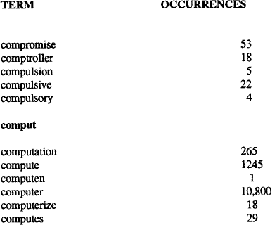
Vocabulary Browse List with entered term "comput"

Slide 65
ITERATIVE SEARCH AND SEARCH HISTORY LOG
The process of refining the results of a previous search to focus on relevant items is called iterative search.
During a login session, a user could execute many queries to locate the needed information
To facilitate locating pervious searches as starting points for new searches, search history logs are available
The search history log is the capability to display all the previous searches that were executed during the current session
The query along with the search completion status showing number of hits is displayed

Slide 66
CANNED QUERY(STORED QUERIES)
The capability to name a query and store it to be retrieved and executed during a later user session is called canned or stored queries
Users tend to have areas of interest within which they execute their searches on a regular basis
A canned query allows a user to create and refine a search that focuses on the user’s general area of interest one time and then retrieve it to add additional search criteria to retrieve data that is currently needed

Slide 67
QUERIES?

